Slide 1

Chapter 19
Network Layer:
Logical Addressing

Slide 2
19-1 IPv4 ADDRESSES
An IPv4 address is a 32-bit address that uniquely and universally defines the connection of a device (for example, a computer or a router) to the Internet.
Topics discussed in this section:
Address Space
Notations
Classful Addressing
Classless Addressing
Network Address Translation (NAT)

Slide 3
IPV4 Address
An IPv4 address is 32 bits long.
The IPv4 addresses are unique and universal.
The address space of IPv4 is 2³² or 4,294,967,296

Slide 4

IPV4 Address
Notation
  Binary Notation :
    The IPV4 address is displayed as 32 bits.
    Each octet is often referred to as a byte.
  Dotted-Decimal Notation
    To make the IPV4 address more compact and easier to read, Internet addresses are written in decimal form with a decimal point (dot) separating the byte.

Slide 5
Notation (cont’d)
Hexadecimal Notation
- 8 hexadecimal digits
- Used in network programming
0111 0101 1001 0101 0001 1101 1110 1010
75 95 1D EA
0x75951DEA

Slide 6

Classful Addressing
In classful addressing, the address space is divided into five classes: A, B, C, D, and E.
  If the address is given in binary notation, the first few bits can tell us the class of the address.
  If the address is given in decimal-dotted notation, the first byte defines the class.

Slide 7
Classful Addressing
Classful Addresses
  Unicast Communication - A, B, C Class
  (~must be delivered to specific computer)
  Multicast Communication – D Class
  (~must be delivered to each member of the group)
  For reserve – E Class

Slide 8

Classful Addressing
Classes and blocks
  One problem with classful addressing is that each class is divided into a fixed number of blocks with each block having a fixed size.
Table 19.1 Number of blocks and block size in classful IPv4 addressing

Slide 9
Classful Addressing
Class A addresses were designed for large organizations
  The most of the addresses were wasted and were not used.
Class B addresses were designed for midsize organizations
  Class B is also too large for many organizations.
Class C addresses were designed for small organizations
  Class C is too small for many organizations.
Class D addresses were designed for multicasting
  Each addresses in this class is used to define one group of hosts on the Internet.
Class E addresses were reserved for future use.
  Only a few used, resulting in another waste of addresses.
  In classful addressing, a large part of
  the available addresses were wasted.

Slide 10
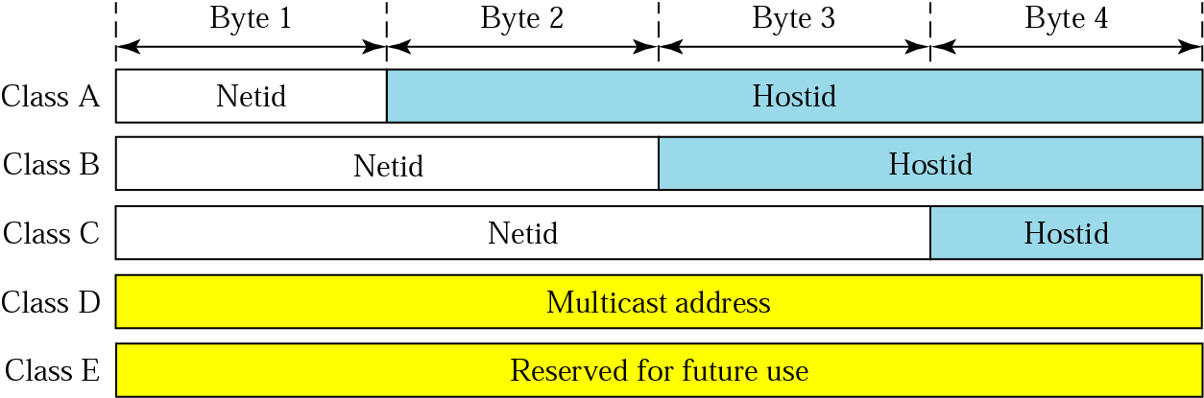
Classful Addressing
Netid and Hostid
  IP address in class A,B, or C is divided into netID and hostID.
    netID defines a Network, and hostID defines a host in the networks.
  The concept does not apply to classes D and E.

Slide 11
MASK
Mask
  When a router receives a packet with a destination address, it needs to route the packet.
  The routing is based on the network address and subnetwork address.
    The router outside the organization has a routing table with one column based on the network addresses;
    The router inside the organization has a routing table based on the subnetwork addresses.
  The mask is a 32-bit binary number, and the mask can help to find the network and subnetwork address.
    The routers outside the organization use a Default Mask to find the network address and,
    The routers inside the organization use a Subnet Mask to find the subnetwork address..

Slide 12

Default Mask
Default Mask
  A default mask is a 32-bit binary number, and the default mask for each class are as follows; 255.0.0.0, 255.255.0.0, 255.255.255.0.
  Default mask gives the network address when ANDed with an address in the block.
    If the bit in the mask is 1, the corresponding bit in the address is retained in the output (no change)
    If the mask is 0, a 0 bit in the output is the result.
Table 19.1 Default masks
CIDR (Classless Inter-domain Routing)

Slide 13
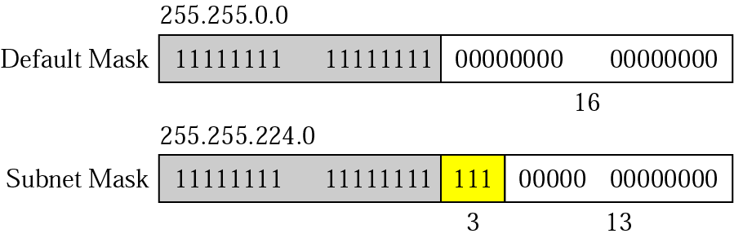
Subnet Mask
Subnetting
  A network is divided into several smaller networks with each subnetwork (or subnet) having its subnetwork address
Subnet Mask :
  We change some of the leftmost 0s in the default mask to make a subnet mask.
  The number of subnets is determined by the number of extra 1s.
    If the number of extra 1s in n, the number of subnets is 2^{n}.
    If the number of subnets is N, the number of extra 1s is log₂ N.
2^{n} = 2³ = 8 subnets

Slide 14
Supernetting and Address depletion
Supernetting
  Combining several class C addresses to create a larger range of addresses
Address Depletion
  The fast growth of the Internet led to the near depletion of the available addresses.
  Classful addressing, which is almost obsolete, is replaced with classless addressing.

Slide 15
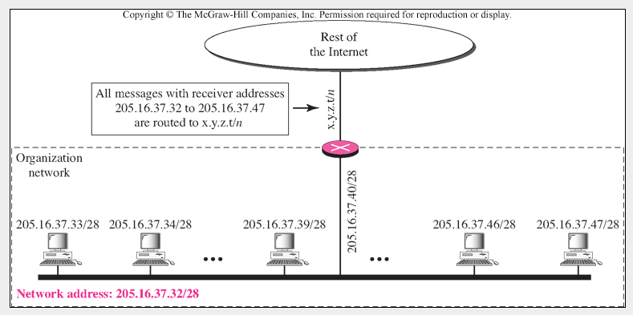
Network Address
Network Addresses
  The first address in a block is normally not assigned to any device;
  It is used as the network address that represents the organization to the rest of the world.
Figure 19.4 A network configuration for the block 205.16.37.32/28

Slide 16

Network Address
Hierarchy
  IP addresses have levels of hierarchy.
  For example, a telephone network has three levels of hierarchy.
    The leftmost 3 digits define the area code, the next 3 digits define the exchange, the last 4 digits define the connection of the local loop to the central office.
Figure 19.5 Two levels of hierarchy in an IPv4 address

Slide 17

Subnetting and Supernetting
Two-level Hierarchy : No Subnetting
  Each IP address in the block can define only two-level of hierarchy when not subnetted.
    the leftmost n bits (prefix) define the network;
    the rightmost 32 − n bits define the host.
  The part of the address that defines the network is called the Prefix;
  The part that defines the host is called the Suffix.
  The prefix is common to all addresses in the network; the suffix changes from one device to another.
Figure 19.6 A frame in a character-oriented protocol

Slide 18

Subnetting and Supernetting
Three-Levels of Hierarchy : Subnetting
  Creating clusters of networks (called subnets)
Figure 19.7 Configuration and addresses in a subnetted network

Slide 19

Subnetting and Supernetting
We have three levels of hierarchy through subnetting.
  The subnet prefix length can differ for the subnets.
Figure 19.8 Three-level hierarchy in an IPv4 address

Slide 20
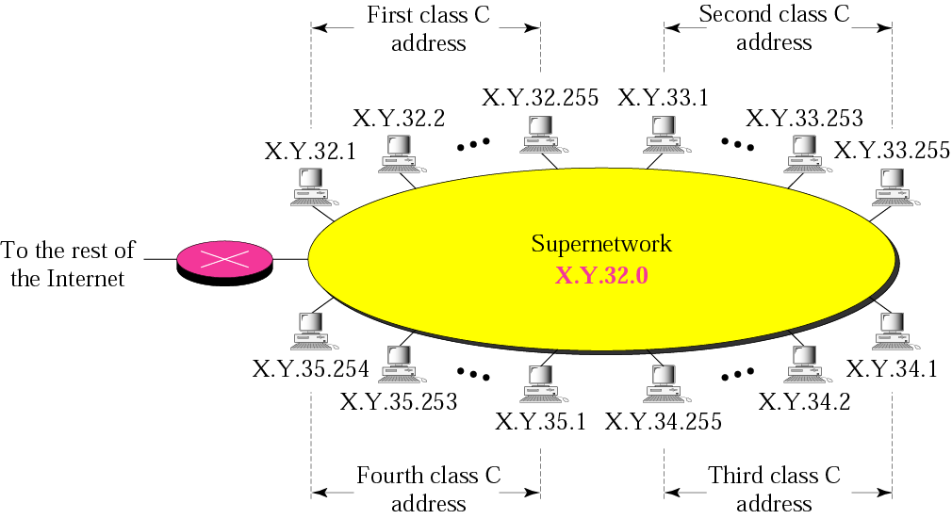
Supernetting
Supernetting
  A maximum number of Class C is 256 addresses,
  If organization needed more addresses, The Supernetting can combine several class C blocks to create a larger range of addresses.
  ( The mask changes from /24 to /22)

Slide 21

Network Address Translation (NAT)
Network Address Translation (NAT)
  NAT enables a user to have a large set of address internally and one address, or a small set of addresses, externally.
  The Internet authorities have reserved 3 sets of addresses as private addresses.
    Any organization can use an address out of this set without permission from the Internet authorities.
    They are unique inside the organization, but they are not unique globally.
    No router will forward this packet as the destination address.
Table 19.3 Addresses for private networks

Slide 22

Network Address Translation (NAT)
NAT Implementation
  The router that connects the network to the global address uses one private address and one global address.
  The private network is transparent to the rest of the Internet; the rest of the Internet sees only the NAT router with the address 200.24.5.8.
Figure 19.10 A NAT implementation

Slide 23

Network Address Translation (NAT)
Address translation
  All the outgoing packets go through the NAT router, which replaces the source address in the packet with the global NAT address.
  All incoming packets also pass through the NAT router, which replaces the destination addresses in the packet with the appropriate private address.
Figure 19.11 Addresses in a NAT

Slide 24

Network Address Translation (NAT)
Translation Table
  When the router translates the source address of the outgoing packet, it also makes note of the destination address – where the packet is going.
  When the response comes back from the destination, the router uses the source address of the packet to find the private address of the packet.
Figure 19.12 NAT address translation

Slide 25

Network Address Translation (NAT)
Using both IP addresses and port numbers
Table 19.4 Five-column translation table

Slide 26
19-2 IPv6 ADDRESSES
Despite all short-term solutions, address depletion is still a long-term problem for the Internet. This and other problems in the IP protocol itself have been the motivation for IPv6.
Topics discussed in this section:
Structure
Address Space

Slide 27

Structure - IPv6
An IPv6 address consists of 16 bytes (Octets); it is 128 bits long.
Hexadeximal Colon Notation
  In this notation, 128 bits is divided into eight sections, each 2 bytes in length.
  Therefore, the address consists of 32 hexadecimal digits, with every four digits separated by a colon.

Slide 28

Abbreviation
Although the IP address, even in hexadecimal format, is very long, many of the digits are zeros.
The leading zeros of a section (four digits between two colons) can be omitted.
  Only the leading zeros can be dropped, not the trailing zeros.

Slide 29
Address Space
IPv6 has a much lager address space; 2¹²⁸ addresses are available.

Slide 30
Summary (1)
At the Network layer, a global identification system that uniquely identifies every host and router is necessary for delivery of packet from host to host.
An IPv4 address is 32 bits long and uniquely and universally defines a host or router on the Internet.
In classful addressing, the portion of the IP address that identifies the network is called the netid.
In classful addressing, the portion of the IP address that identifies the host or router on the network is called the hosted.
An IP address defines a device’s connection to a network.
There are five classes in IPv4 addresses. Classes A, B, and C differ in the number of hosts allowed per network. Class D is for multicasting and Class E is reserved.

Slide 31
Summary(2)
The class of an address is easily determined by examination of the first byte.
Addresses in classes A, B, or C are mostly used for unicast communication.
Address in class D are used for multicast communication.
Subnetting devides on large network into several smaller ones, adding an intermediate level of hierarchy in IP addressing.
Supernetting combines several networks into one large one.
In classless addressing, we can divided the address space into variable-length blocks.

Slide 32
Chapter 20
Network Layer:
Internet Protocol

Slide 33
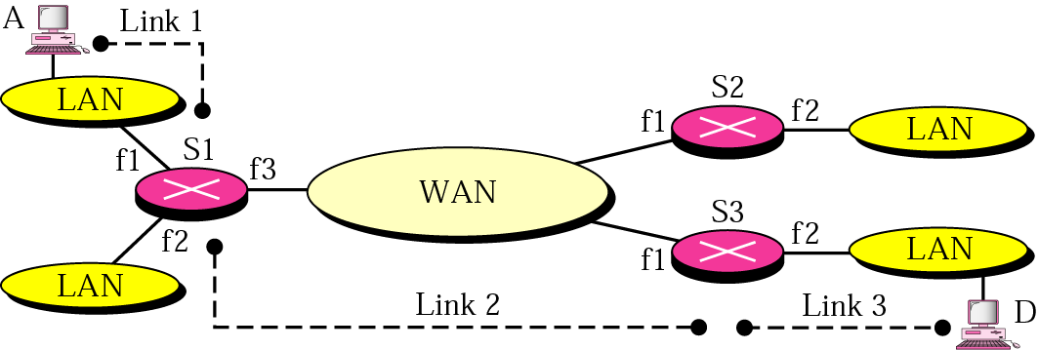
Internetworking
Internetworking
  The physical and data link layers of a network operate locally.
  These two layers are jointly responsible for data delivery on the network from one node to the next.
R
R2
R1
R3

Slide 34

Internetworking
When data arrive at interface f1 of R1, how does R1 know that interface f3 is the outgoing interface ?
  There is no provision in the data link (or physical) layer to help R1 make the right decision. The frame dose not carry any routing information either.
  The frame contains the MAC address of the A and R1.
A LAN or a WAN carry the frame through one link.
R1
R2
R2
R1
R3

Slide 35

Internetworking
Need for Network Layer
  To solve the problem of delivery through several links, the network layer (or the inter network layer, as it is sometimes called) was designed.
  The network layer is responsible for host-to-host delivery and for routing the packets through the routers or switches.
R1
R2
R2
R1
R3

Slide 36
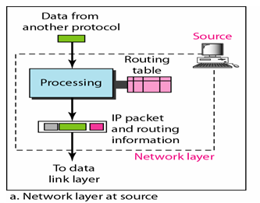
Internetworking
Network layer at the source
  The network layer is responsible for creating a packet from the data coming from another protocol.
  The header of the packet contains, among other information, the logical addresses of the source and destination.
  The network layer is responsible for checking its routing table to find the routing information.
  If the packet is too large, the packet is fragmented.

Slide 37

Internetworking
Network layer at the switch or router
  The network layer is responsible for routing the packet.
  When a packet arrives, the router or switch consults its routing table and finds the interface from which the packet must be sent.
  The packet, after some changes in the header, with the routing information is passed to the data link layer again.

Slide 38
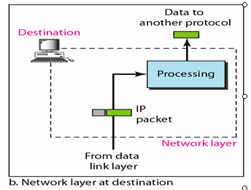
Internetworking
Network layer at the destination
  The network layer is responsible for address verification;
  It makes sure that the destination address on the packet is the same as the address of the host.
  If he packet is a fragment, the network layer waits until all fragments have arrived, and then reassembles them and delivers the reassembled packet to the transport layer.

Slide 39
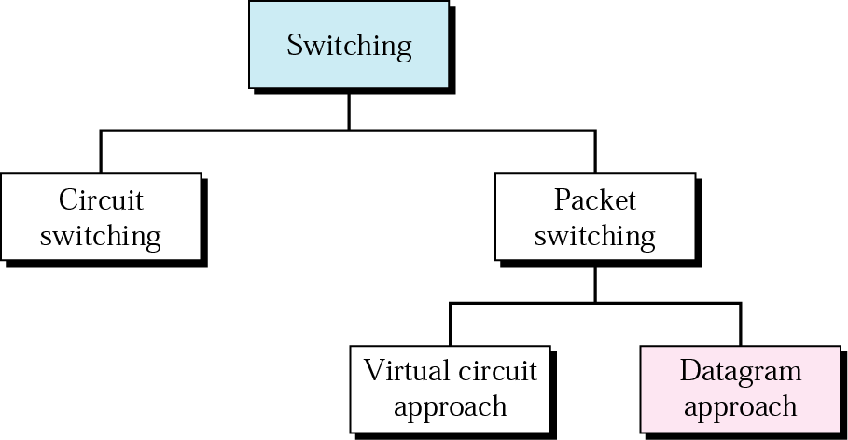
Internet as a Datagram Network
The Internet, at the network layer, is a packet switched network.
The Internet has chosen the datagram approach to switching in the network layer.
It uses the universal addresses defined in the network layer to route packets from the source to the destination.

Slide 40
Internet as a Connectionless Network
Connection-oriented service
  The source first makes a connection with the destination before sending a packet.
  When the connection is established, a sequence of packets can be sent one after another.
  They are sent on the same path in sequential order.
  When all packets of a message have been delivered, the connection is terminated.

Slide 41
Internet as a Connectionless Network
Connection-oriented service
  The source first makes a connection with the destination before sending a packet.
  When the connection is established, a sequence of packets can be sent one after another.
  They are sent on the same path in sequential order.
  When all packets of a message have been delivered, the connection is terminated.

Slide 42
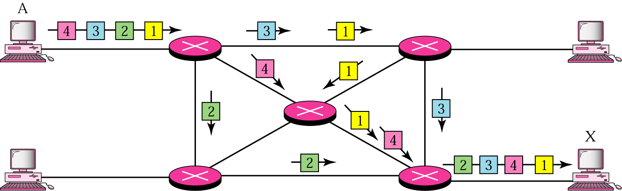
Internet as a Connectionless Network
Connectionless service
  The network layer protocol treats each packet independently, with each packet having no relationship to any other packet.
  The packets in a message may or may not travel the same path to their destination.
  This type of service is used in the datagram approach to packet switching.
  Communication at the network layer in the Internet is connectionless.

Slide 43
20-2 IPv4
The Internet Protocol version 4 (IPv4) is the delivery mechanism used by the TCP/IP protocols.
Topics discussed in this section:
Datagram
Fragmentation
Checksum
Options

Slide 44

IPv4
Figure 20.4 Position of IPv4 in TCP/IP protocol suite

Slide 45
IPv4
Best-effort delivery
  IPv4 is an unreliable and connectionless datagram protocol - a best-effort delivery service.
  The term best-effort means that IPv4 provides no error control or flow control (except for error detection on the header).
Connectionless protocol
  Each datagram is handled independently, and diagrams sent by the source to the same destination could arrive out of order.
  Also, some could be lost or corrupted during transmission.
  IPv4 relies on a high-level protocol to take of all these problem.

Slide 46

IPv4 Datagram
  Packets in the IPv4 layer are called Datagrams.

Slide 47
IPv4 Datagram (cont’d)
A datagram is a variable-length packet consisting of a header and data.
Header
  length : 20 – 60 bytes
  Contains information essential to routing and delivery.
Version (VER) : It defines the Version of IPv4. it is 4.
Header Length (HLEN) : Defining the total length of the datagram header in 4byte words.

Slide 48

IPv4 Datagram (cont’d)
Differentiated Services
  The first 3 bits are called precedence bits. The next 4 bits are type of service (TOS) bits, and the last bit is not used.
  The precedence subfield was part of version 4, but never used.
Figure 20.6 Service type or differentiated services

Slide 49

IPv4 Datagram (cont’d)
Protocol
  Defining the higher level protocol that uses the services of the IP layer
    TCP, UDP, ICMP, and IGMP
    Multiplexing data from different higher level protocols
Value
Protocol
1
ICMP
2
IGMP
6
TCP
8
EGP
17
UDP
89
OSPF

Slide 50
Summary
IPv4 is an unreliable connectionless protocol responsible for source-to-destination delivery.
Packets in the IPv4 layer are called datagrams. A datagram consistes of a header(20 to 60 bytes) and data. The maximum length of a datagram is 65,535 bytes.
The MTU is the maximum number of bytes that a data link protocol an encapsulate. MTU vary from protocol to protocol.
Fragmentation is the division of datagram into smaller units to accommodate the MTU of a datalink protocol.
The IPv4 datagram header consists of a fixed, 20-bte section and a variable options section with a maximum of 40 bytes.
The options section of the IPv4 header is used for network testing and debugging.

Slide 51
Summary (2)
The six IPv4 options each have a specific function.
IPv6, the latest version of the Internet Protocol, has a 128-bit address space, a revised header format, new options, an allowance for extension, support for resource allocation, and increased security measures.
An IPv6 datagram is composed of a base header and a payload.
Extension header add functionality to the IPv6 datagram.
Three strategies used to handle the transition for version 4 to version 6 are dual stack, tunneling, and header translation.

Slide 52

Thanks !

